Slide 1
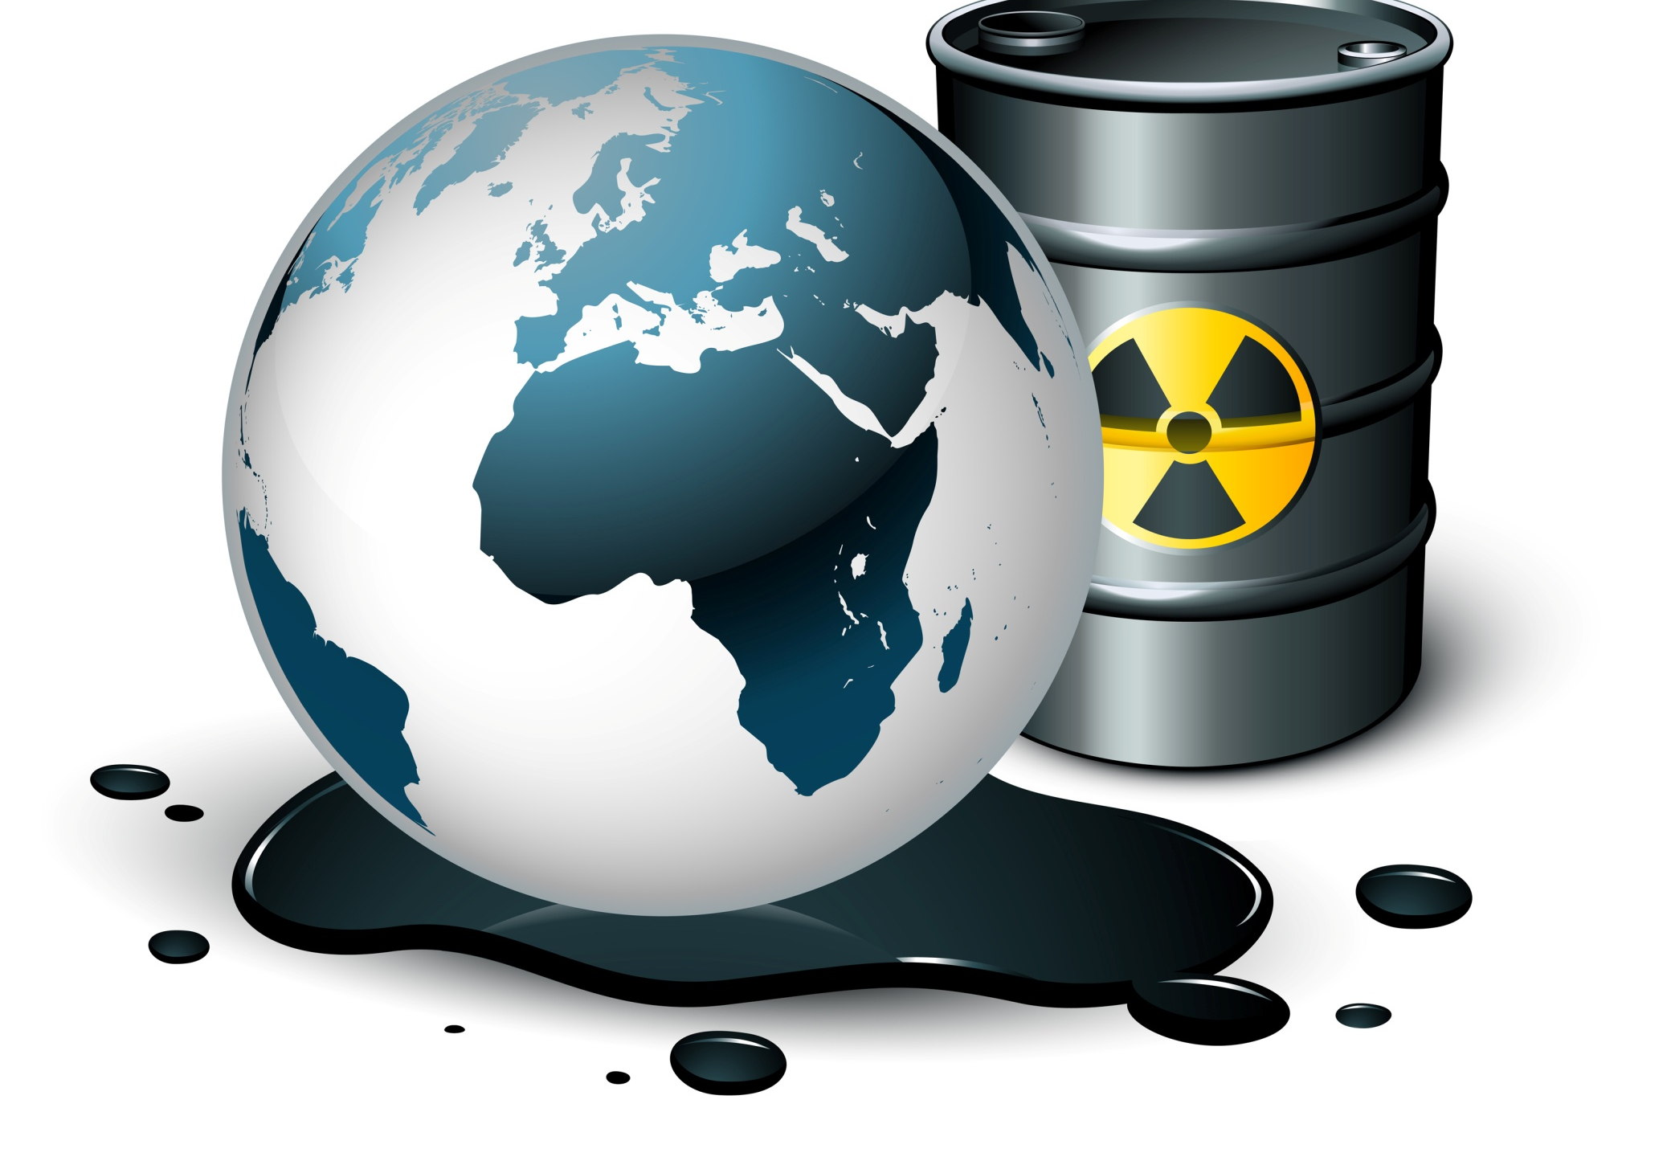
The Invisible Killers
The Unseen Dangers of a Toxic World

Slide 2

Our Toxic World, Our Body Burden
  Multiple environmental toxins
  Total load exceeds the body’s ability to adapt
  The Damages:
    Immunotoxicity
      Asthma, Allergies, Cancers & Chronic Disease
    Neurotoxicity
      Cognition, Memory, Sensory & Motor Dysfunction
    Endocrine toxicity
      Reproduction, Libido & Metabolism
Notes:
RELATED RESEARCH / STATS (Toxic Overload)
According to the Chairman of the American Board of Clinical Metal Toxicology, “Most of the diseases of aging—vascular, most cancers, arthritis and others—have been shown to be associated with toxic metals and persistent organic pollutants. Vascular diseases, stroke, heart attack, plus most of the cancers and macular degeneration, have been directly linked to lead.
Humans are now struggling under a burden of multiple environmental toxins. For many individuals, this is not from workplace exposure, but from simply living in a polluted world. Some individuals appear to be less able to clear the daily chemical exposure from the body than others, leading to a total load of toxins that exceeds the ability of the body to adapt. When the toxic load reaches this point, damage to certain organ systems can occur. The major organ systems affected are the immune, neurological, and endocrine systems. Immunotoxicity may be the major factor in the increasing rates of asthma, allergies, cancers, and chronic viral infections. Neurological toxicity can affect cognition, mood, and cause chronic neurological illnesses. Endocrine toxicity can affect reproduction, menses, libido, metabolism, stress-handling ability, glucose regulation, and other important functions. While this all seems overwhelming, there are ways to approach these problems. (Source: Altern Med Rev 2000)

Slide 3
How Are We Exposed?
In the Air: Heavy Metals, volatile organic, fine particles, various gasses, molds and spores
In the Water: Bacteria and protozoa, persistent organics chemicals (DDT, PCB’s, dioxin, PBDE’s), pesticides, MTBE from gasoline, fluoride, chlorine and trihalomethanes
In The Food We Eat: Heavy metals, pesticides, hormones, food preparation (C8 or PFOA from non-stick cookware, Aluminum from cookware)
And…from the ones who love us!

Slide 4
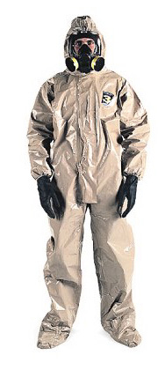

Global Concern
It’s In the Air
Americans – 116 toxic chemicals – up from 27 in 2001
Asia – 1M die from pollutants
Sweden – increased risk of diabetes linked to exposure to PCB’s, POP’s and insecticides
1460 metric tons of airborne toxins travel the jet stream around the world
Notes:
RELATED RESEARCH / STATS (global problem)
Studies by the Centers for Disease Control and Prevention (CDC) show that Americans of all ages carry a body burden of at least 116 chemicals (up from 27 in 2001), some of them banned for more than two decades because of toxicity.
One million people in the Western Pacific Region* die each year from environmental health risks, and the World Health Organization predicts a worsening scenario if effective measures to deal with growing industrialization and urbanization are not taken now. In the Region, about 580 000 deaths per year are attributable to traditional environmental risks-indoor smoke from solid fuels; and unsafe water, sanitation and hygiene. Modern risks, such as urban air pollution and exposure to lead and other pollutants, are responsible for 405 000 deaths, 96% of which occur in developing countries of the Region (Source: World Health Organization)
Studies by a University of Washington researcher show a startling amount of made-in-China pollution rides to America on the jet stream and ends up in our lungs. “Asian puffs” of bad air carry mercury, carbon monoxide, aerosols, hydrocarbons and nitrogen oxides 6,000 miles across the Pacific Ocean, adding significantly to the toxins in our air and water. As much as 1,460 metric tons of mercury, a powerful neurotoxin, blew out of China last year – twice as much as previously thought. Scientists now believe Asia contributes as much as a third of all airborne mercury deposited in the United States. Inhaling mercury has harmful effects on the nervous, digestive and respiratory systems, and the kidneys. (Source: The News Tribune)
Walking close to the edge of the curb exposes pedestrians to up to a tenth more pollutants than on the building side. News of the study came as the Scottish Green Party called for tougher action on traffic pollution, which it said kills 2,000 people a year north of the Border. In the pavement research, a team from Imperial College London found people walking nearest the road encountered higher concentrations of ultrafine particles, or PM2.5, which are associated with respiratory illnesses and cancer, than those on the inner side, nearest buildings. (Source: New Scientist Magazine)
Exposure to high levels of environmental pollutants may increase the risk of type 2 diabetes, according to a new study. Previous studies linked exposure to organo-chlorine pollutants (POPs) with asthma, diabetes and many types of cancer. The current study, conducted by researchers from the University of Lund in Sweden, found diabetics were more likely to have high levels of POPs such as polychlorinated biphenyls (PCBs) and the insecticide dichloro-diphenyl-trichloroethane or DDT in their blood. Researchers suspected that oily fish such as salmon, which is often contaminated with pollutants such as dioxin and PCBs, may be an important source of contamination that attributes to the development of diabetes. The study involved 196 fishermen and their spouses. Blood samples from the participants were analyzed for a POP residue known as CB-153, a biomarker of PCBs, and DDE, the main by-product of DDT. It was found that six percent of men and five percent of their wives who had type 2 diabetes had high concentrations of both chemicals. (Source: Altern Med Rev 2000)

Slide 5
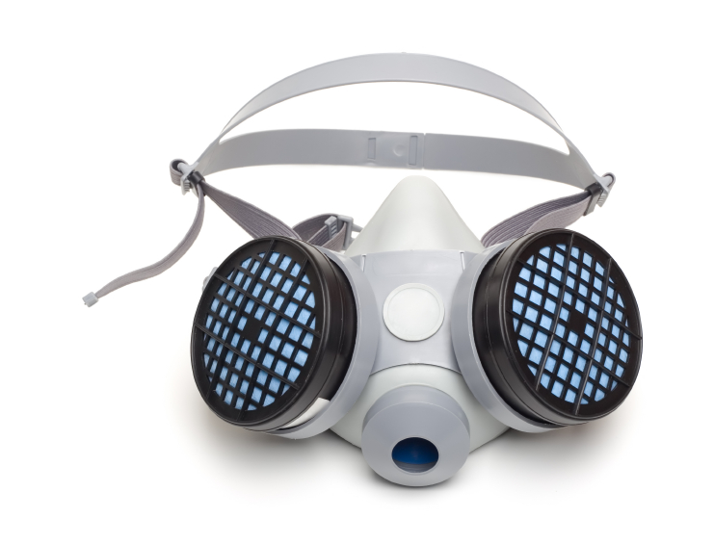
We’re Surrounded
It’s In the Air
  Inhale 5000 gallons of air each day
  US facilities released 4.7 B lbs of toxins into the air – 72 M lbs are known carcinogens
  Chicago – 68 days when air was too unhealthy for children, elderly & the ill
  Fine particle pollutants (car exhaust & power plants), correlate with increase risk of dying from any cause
Notes:
RELATED RESEARCH / STATS (Air)
The EPA reports that in 2002 24,379 US facilities released 4.7 billion pounds of toxins into the atmosphere. 72 million pounds were known carcinogens.
Depending on your size you inhale 3,000 to 8,000 gallons of air each day
Manufacturing, transportation, electricity generation, and other human activities spew a bewildering array of pollutants into that air—taking its toll on our health.
A long-term Harvard study begun in the mid-1970s showed one important effect of chronically breathing polluted air: additional early deaths due to cardiovascular disease.
Recently, a group from the University of Southern California showed another -- more atherosclerosis, the process that leads to cholesterol-clogged arteries.
According to a report published last October in Stroke, Medicare records on more than 150,000 people hospitalized for stroke in nine U.S. cities found that an increase in air pollution from the lowest to the highest concentrations was associated with a 1.03 percent increase in incidence.
According to the EPA, Fine-particle pollution causes an estimated 20,000 premature deaths in the United States each year. Further, emissions of nitrogen oxide and sulfur dioxide from power plants form smog and soot and are linked to thousands of premature deaths and illnesses every year.
The weight of this reality can be felt across the globe, According to the European Commission, some 39,000 deaths in the UK are caused or hastened by air pollution.
Women who live in areas with greater air pollution have a higher susceptibility of developing and dying from coronary heart disease (CHD), according to a multi-decade study accepted today for publication in the peer-reviewed journal Environmental Health Perspectives (EHP). When ozone combines with particulate matter (PM), women’s risk of fatal CHD can increase up to twofold.

Slide 6
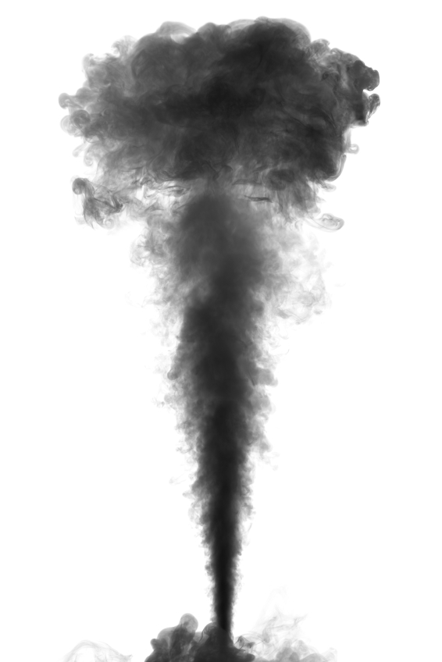
We’re Surrounded
It’s In the Air
  Coal-fired power plants spew sulfates, nitrates and mercury into the air—linked to >20,000 premature deaths each year
  10% of women carry mercury concentrations high enough for fetal damage
  Manufacturing, transportation, electricity generation and other human activities are taking its toll on our health and environment
Notes:
RELATED RESEARCH / STATS (Air)
Coal-fired plants emissions such as sulfur dioxide and nitrogen oxide have been shown to cause respiratory and heart disease and are believed responsible for 20,000 premature deaths a year. (Source: The Register-Guard)
According to the American Lung Association, there were 68 days last year when the air in Cook County Chicago was unhealthy for children, the elderly, and people with respiratory diseases such as asthma. There were also five days in which the air was so unhealthy it could have possibly caused respiratory problems in the general population. (Source: The Columbia Chronicle)
From the study carried out in the University of Southern California, Los Angeles, researchers found that as the number of fine particles of pollutants less than 2.5 microns in diameter increased, so, too, did the risk of dying. The result showed that each jump of 10 micrograms per cubic meter corresponded to an 11-17 percent increase in the risk of dying from any cause.
New York University School of Medicine researchers provide some of the most compelling evidence yet that long-term exposure to air pollution—even at levels within federal standards—causes heart disease. In a well-designed mouse study, where animals breathed air as polluted as the air in New York City, the researchers pinpointed specific mechanisms and showed that air pollution can be particularly damaging when coupled with a high-fat diet. The study, done in collaboration with the Mount Sinai School of Medicine and University of Michigan, looked at the effects of airborne particles measuring less than 2.5 microns, referred to as PM2.5, the size linked most strongly with cardiovascular disease. The emissions arise primarily from power plants and vehicle exhaust.(Source: JAMA, Dec 2005)
Polluted air with fine particles, when inhaled, raises the risk of ischemic stroke - a type of stroke that is caused by a blood clot in the brain - according to a new study conducted at the Beth Israel Deaconess Medical Center (BIDMC) and the Harvard School of Public Health (HSPH). (Source: Stroke, December 2005)
Sulfates and nitrates (from SO2 and NOx) are major components of the fine particle pollution that plagues many parts of the country, especially those communities nearby and directly downwind of coal-fired power plants. Harvard School of Public Health studies have shown that sulfur dioxide emissions from power plants significantly harm the cardiovascular and respiratory health of people who live near the plants. According to Environmental Protection Agency studies, fine particle pollution from power plants causes more than 20,000 premature deaths a year. Ground-level ozone, which is especially harmful to children and people with respiratory problems such as asthma, is formed when NOx and volatile organic compounds (or VOCs) react in sunlight.
Coal-fired power plants are the single largest source of mercury air pollution, accounting for roughly 40 percent of all mercury emissions nationwide. Mercury is a highly toxic metal that, once released into the atmosphere, settles in lakes and rivers, where it moves up the food chain to humans. In 2003, the Centers for Disease Control found that roughly 10 percent of American women carry mercury concentrations at levels considered to put a fetus at risk for neurological damage

Slide 7

We’re Surrounded
There Must Be Something
In the Water
  7 M illnesses & 1000 deaths each year in US from waterborne microbes
  Chlorinated chemicals in drinking water linked to increased risk of breast cancer
  Cyanobacterial toxins linked to illness and disease worldwide
  Sewage treatment plant workers at much higher risk of respiratory illness, skin rashes, headaches & body aches
Notes:
RELATED RESEARCH / STATS (Water)
According to the NJ Times, Last August 50 millions gallons of water from an ash (as well as fine particles of dust and soot that contains arsenic, mercury, lead and other pollutants) settling basin was dumped into the Delaware River
Exposure to bacterial toxins may cause flulike symptoms, breathing problems and skin reactions in some workers at sewage treatment plants, a study has found. Researchers in the Netherlands found that workers at 67 sewage treatment plants had heightened risks of daily cough, shortness of breath, skin rash and flu-like symptoms such as headache and body aches and pains. The culprit, say the researchers, seems to be the toxins that are released from both sewage bacteria and the bacteria that are used to remove pollutants from the wastewater. Symptoms were not limited to maintenance workers and technicians; office staff, also reported breathing problems and other symptoms.(Source: The American Journal of Industrial Medicine)
Outbreaks of waterborne disease are on the increase. An estimated 7 million people become sick and more than 1,000 die in the United States each year from waterborne microbes. (Source: Mediasyndicant.com)
Chlorinated chemicals were associated with elevated risk of breast cancer in several studies.
Taiwanese electronics workers exposed to chlorinated solvents were found to have an increased risk of breast cancer.
Massachusetts women exposed to perchlorethlylene contaminated drinking water were found to have a small to moderate increased risk of breast cancer.
A biomonitoring study in Belgium found higher levels of DDT and hexachlorobenzene (HCB) among breast cancer patients than in women without the disease. The solvent ethylene glycol methyl ether (EGME) and its metabolite, 2-methoxyacetic acid (MAA) were found to sensitize breast tissue cells to the effects of estrogens and progestins, thereby increasing the risk of breast cancer. EGME is used in the semiconductor industry and is also a component in varnishes, paints, dyes and fuel additives.
Polychlorinated biphenyls (PCBs) were implicated in breast cancer recurrences in a study of 224 women on Long Island, N.Y.
Cyanobacteria – Toxins produced from blue-green algae. Exposure can be through drinking or skin exposure. Toxins can cause a variety of ailments including skin rashes, allergies, vomiting, headache, joint pain, liver toxicity and neurotoxicity.

Slide 8

We’re Surrounded
Don’t Eat That!
  Environmental toxins work their way into the food chain
  47 states have advisories to limit intake of freshwater fish due to mercury contamination
  Chlorinated pesticides
    FDA finds DDE in 63% of foods surveyed
    Strongly immunotoxic
    Present in 84% of fruit & vegetables to schools
  Herbicides in food linked to many cancers
Notes:
RELATED RESEARCH / STATS (Food)
Mercury in rivers is so pervasive that 47 states now have posted advisories either statewide or for specific waters instructing people to limit their intake of freshwater fish. Exposure to high levels of mercury can harm the brain, heart, kidneys, lungs and immune systems of humans. (Source: Hartford Courant)
Ninety-three percent of American processed cheese, hamburger, hot dogs, bologna, collards, chicken, turkey, and ice cream sandwiches contained DDE. DDE was found in 87 percent of lamb chops, salami, canned spinach, meatloaf, and butter, and in 81 percent of samples of cheddar cheese, pork sausage, hamburger, white sauce, and creamed spinach. Of all items sampled, 42 had DDE in 63 percent or more of all samples. (Source: Altern Med Rev 2000)
For adults the use of chlorophenoxy acid herbicides (such as 2,4-D) has been strongly associated with increased incidence of lung cancer, stomach cancer, leukemia, Hodgkin's lymphoma (two studies found a five-fold risk), non-Hodgkin'[s lymphoma (NHL – five to six-fold increased risk), and soft tissue sarcomas (many studies have shown a five to seven-fold increased risk, and one review study reported a 40-fold increased risk).36 2,4-D gained notoriety from its combination with 2,4,5-T to form a mixture known as Agent Orange. 2,4-D is commonly used by municipalities and states as a spray on roadways and right-of-ways to inhibit weed growth. It can be purchased at home stores for home lawn care and is often applied by chemical lawn care companies. (Source: Altern Med Rev 2000.)
Exposure to the insecticide DDT, first used in the 1950s, has also been linked to an increased risk of diabetes. One study considering the effect of DDT was conducted by John Beard and colleagues from Southern Cross University in Australia and published in the May, 2003 issue of Environmental Health Perspectives. The study found on-job exposure to DDT and other pesticides were associated with asthma and pancreatic cancer in addition to diabetes. (Source: Altern Med Rev 2000.)
Research by the Soil Association has found that 84 percent of fruits and vegetables given to school, children contain one pesticide, 65 percent of the samples contain two or more pesticides. (Source: Soil Association Organic Standard, September 2005)

Slide 9

Home Sweet Womb
Even Before We’re Born
Average newborn has 200 different industrial chemicals, pollutants & pesticides in blood
    Carcinogens
    Toxic to brain & nervous system
    Abnormal development
Urban air pollution linked to chromosomal abnormalities in infants in NYC
Notes:
RELATED RESEARCH / STATS (Womb Exposure)
At the University of Rochester, scientists are investigating the effects on an infant of a pregnant woman's exposure to chemicals, such as phthalates. The hormone-disrupting compounds used to soften plastics are found in many cosmetics, lotions, shampoos and baby products. The researchers are following up on previous observations that a mother-to be's chemical encounter can affect her infant son's genital development. (Source: Sciencedaily.com)
Another group at the school is conducting a 16-year study of the impact of a woman's eating habits during pregnancy on her offspring. The survey of more than 700 children in the Seychelles Islands, off the African coast, is exploring the effects on growing youngsters of small amounts of mercury in ocean fish such as tuna and swordfish. Some environmental groups have claimed hundreds of thousands of U.S. children are at risk of neurological impairment because their mothers consumed mercury-tainted fish after conception. (Source: Sciencedaily.com)
A University of Southern California study suggests babies born to women exposed to high ozone levels during pregnancy are at risk for being underweight. The researchers found women who breathe air heavily polluted with ozone are at risk for having babies afflicted with intra uterine growth retardation. That means their babies only fall within the 15th percentile of expected size. Fetal growth and birth weight are strongly linked to morbidity and mortality during childhood and adulthood. (Source: The Environmental Health Perspectives)
In Sidney, BC and Winnipeg, Manitoba, scientists were analyzing the blood from 10 umbilical cords, which mothers had donated to the Red Cross’s cord blood collection program, commissioned by the Environmental Working Group, based in Washington DC and Oakland, California, for use in the treatment of leukemia, sickle cell anemia, and bone marrow failure. The scientists were also looking for evidence of chemical contamination of the blood, and that is what they found. If these 10 randomly chosen cords are an example, the average newborn baby has 200 different industrial chemicals, pollutants and pesticides in his/her body at the moment of birth. Two hundred chemicals and other pollutants, including mercury, polyaromatic hydrocarbons, dioxins, furans, pesticides, and chemicals from flame retardants, PCBs, industrial lubricants, plastics, Teflon, Scotchgard, industrial bleaches, electrical insulators, coal-fired power plants, vehicle emissions, and wood preservatives. In total, the scientists found 287 industrial chemicals in the blood, an average of 200 chemicals per baby. Of the 287 chemicals detected, 180 are known to cause cancer in humans or animals, 217 are known to be toxic to the brain and nervous system, and 208 are known to cause birth defects or abnormal development in animal tests. (Source: BodyBurden, The Pollution of Newborns. Environmental Working Group, July 2005.)
Worse still, research proves that exposure to urban air pollution can affect the chromosomes of a developing fetus. It is known that babies born to mothers exposed to high levels of urban air pollution tend to have a greater chance of chromosomal abnormalities than those whose mothers breathed cleaner air. An instance of this was showcased at the Columbia Center for Children’s Environmental Health. The study involved 60 infants born in New York City to non-smoking mothers who were participated in the study long before they gave birth. The team analyzed exposure rates to airborne pollutants known as polycyclic aromatic hydrocarbons which are part of the constituents of motor vehicle exhaust gases, power plant emissions and of course, tobacco smoke. The study, conducted in low-income Manhattan neighborhood, where exhaust pollutants are prevalent, involved the mothers-to-be filling out questionnaires and wearing a portable air monitor for 48 hours during their third trimester. After they gave birth, analyses of samples of umbilical cord blood showed that exposure to combustion pollutants was positively linked to chromosomal abnormalities in fetal tissue. (Source: vanguardngr.com)

Slide 10

Mothers Give More than Love…
To Fetus across the Placenta
  Pregnancy mobilizes fat soluble POP’s (dioxin, DDT, PCB’s, flame retardants like PBDE’s)
  Lead and methylmercury actively transported
  Fetus: immature metabolism results in sequestration in fetal brain
  Multiple studies (US, Netherlands, Canada) document: >200 chemicals in cord blood

Slide 11

...And More than Nourishment
Toxins in breast milk increase the toxic load
  POP’s are bio-concentrated in fat
  Lactation mobilizes fat stores and associated chemicals
  POP’s transmission in milk much greater than placental
  Heavy metals Mercury, Cadmium, Lead…all concentrated in breast milk
  Volatile Organics also found in low levels

Slide 12

Exposed To The Elements
  Fluoride
    Fluorinated drinking water linked to Osteosarcoma & Hypothyroidism
  Vaccinations
    Thimerosal causes autism in children
  Radiation
    Increased radiation exposure contributed to rising incidence of breast cancer between 1950 & 1991
Fluoride-Vaccinations-Radiation
Notes:
RELATED RESEARCH / STATS (Fluoride/vaccines/Radiation)
Fluoride – A doctoral student at Harvard found that boys who drank fluorinated water acquired the bone cancer ostesarcoma more often than those who didn’t (a seven-fold increase)
Vaccinations – Mandatory vaccine programs. According to the GAO (1999) in the 1990’s an estimated 12 million vaccinations were given each year and more than 40 million children were vaccinated. Since the 1930” the mercury-based Thimerosal has been added to vaccines as a preservative, allowing vaccines to be manufactured in bulk instead of individual doses. In 1980’s FDA bans thimerosal in OTC products (Merthiolate) and in 1991 considered banning in vaccines but didn’t. CDC then increases the number of vaccines to children and no one took the time to calculate the cumulative mercury dose in these children through the 1990’s. In fact, it was 187 times the EPA’s limit for daily exposure to mercury and the rate of Autism explodes. Iowa had an increase of 700% in autistics throughout the 1990’s and in 2004 became the first state to ban mercury in vaccines followed CA.
Ionizing radiation is the best-established environmental cause of human breast cancer. In 1972 the radiaiton dose per mammogram averaged 2 rads, a dose 10X greater than the current dose. CT scans introduced in the 1970’s greatly increased the radiation dose per exam compared to ordinary xrays. Between 1950 and 1991, the incidence of breast cancer in the US increased by 90% due to an increase in radiation exposure from multiple sources.

Slide 13

The Price of Progress
Motor Vehicles
  Gasoline & diesel fuels contain toxins
  Engine exhaust
    Benzene causes cancer
    Particulate matter damages lung tissue, lowers resistance to infection & worsens chronic lung diseases
  Exposure linked to lung cancer
    Urban areas
    Industry workers at higher risk
Notes:
RELATED RESEARCH / STATS (Cars)
Gasoline and diesel fuels contain toxic substances that can enter the environment and cause adverse health effects in people. Some of these substances, such as benzene, toluene and xylenes, are found in crude oil and occur naturally in fuels and their vapors. Other substances, such as 1,3-butadiene and formaldehyde, are formed in engines during combustion and are only present in exhaust. Other harmful pollutants found in engine exhaust include particulate matter (known more commonly as soot), nitrogen oxides, carbon monoxide, sulfur dioxide and various hydrocarbons. Ozone, the major component of urban smog, is formed when nitrogen oxides react in sunlight with hydrocarbons. Diesel exhaust is a particular health concern as it contains over 40 different substances identified by the California Air Resources Board (ARB) as toxic air contaminants that may pose a threat to human health and has been linked to lung cancer. Just breathing the air exposes people to fuel components, especially in urban areas. People are exposed to gasoline and diesel exhaust when they drive or ride in a vehicle, jog or bike along roads or park in a public garage. Motorists are further exposed to gasoline vapors when they fill up their vehicle’s fuel tank. People who work in or live near freeways, refineries, chemical plants, loading and storage facilities or other places that handle crude oil and petroleum products may be exposed to higher levels of fuel components than the general public and face higher health risks. (Source: The California Environmental Protection Agency’s Office of Environmental Health Hazard Assessment & The American Lung Association)
Both liquid gasoline and motor vehicle exhaust contain chemicals that can cause cancer. Benzene, a fundamental component of gasoline and diesel fuel as well as vehicle exhaust, causes cancer in humans. Gasoline exhaust also contains cancer-causing 1,3-butadiene, formaldehyde and acetaldehyde. Diesel exhaust contains several dozen toxic substances and scientific studies have shown that workers exposed to diesel exhaust are more likely to develop lung cancer. Long-term exposure to particles in diesel exhaust poses the highest cancer risk of any toxic air contaminant evaluated by OEHHA. ARB estimates that about 70 percent of the cancer risk that the average Californian faces from breathing toxic air pollutants stems from diesel exhaust particles. The microscopic particles making up diesel exhaust particulate matter are less than one-fifth the thickness of a human hair. They are small enough to penetrate deep into the lungs, where they can contribute to respiratory disease. Gasoline and diesel exhausts contain nitrogen oxides, carbon monoxide and sulfur dioxide. Nitrogen oxides can damage lung tissue, lower the body’s resistance to respiratory infection and worsen chronic lung diseases such as asthma. As mentioned earlier, nitrogen oxides react in the atmosphere with hydrocarbons to form ozone, the major component of urban smog. (Source: The California Environmental Protection Agency’s Office of Environmental Health Hazard Assessment & The American Lung Association)
Diesel exhaust is a particular health concern as it contains over 40 different substances identified as toxic air contaminants that have been linked to lung cancer.
Exposure – Especially in urban areas, people are exposed when they drive or ride in a vehicle, jog or bike along roads or park in a public garage. Further exposed when they fill up their tank and certainly workers are exposed at higher rates.

Slide 14

No Place Like Home
What’s Under the Sink?
  Cleaning products – ADHD & learning disorder
  Fabric dryer sheets
  Fragrances & air fresheners
  Indoor air contamination 1000 times greater than outdoors
Teflon (C8)
  Non-stick cookware, water-proof clothing, furniture & food wrappers
  Linked to cancers & toxic gas emission
Notes:
RELATED RESEARCH / STATS (Things in our home)
Many consumers bring toxins into their homes themselves. Many of the products believed to improve the look and scent of homes can actually harm the people living there. This brings up the question of whether these household-cleaning products might at least partially cause ADHD and other learning and behavioral disorders. Unfortunately, these cleaners aren't the only consumer products containing chemicals. Fabric dryer sheets actually put petroleum and potentially dangerous artificial fragrances on clothes and air fresheners also contain these fragrances, which may interfere with hormone communication systems. (Source: Newstarget.com)
A chemical found in cleaning materials, textiles and plastics pose a breast cancer threat. According to the Journal of Applied Toxicology scientists from Texas and Southern Carolina reports 4-nonylphenol, triggers breast cancer in mice. Nonylphenol mimics female sex hormone oestrogen once in the body. In the liver, it stimulates an enzyme system that in turn increases the production of another similar hormone estriol. Both oestrogen and estriol have been linked with breast cancer. It also binds to oestrogen receptors in the breast that can trigger cancer growth to a greater extent than oestrogen.
Pollutants inside buildings vastly outnumber those outside, said Jed Waldman, who heads the Indoor Air Quality program at the California Department of Health Services. And the chances of breathing a pollutant released indoors are 1,000 times greater than if it is released outside, he said.
The scientific community is getting more serious about the carcinogenicity of Teflon chemical PFOA or C8, manufactured solely by DuPont. The Environmental Protection Agency (EPA)'s Science Advisory Board voted unanimously Wednesday to recommend that the descriptor of PFOA should be upgraded from the current "suggestive carcinogen" to a "likely carcinogen", Associated Press reported. A previous EPA's review resulted in the current status of the Teflon chemical PFOA. PFOA is a processing aid used in the manufacture of anti-grease and water-proof fluoropolymers, which are widely used in many products that need these anti-grease and water-repellent properties such as non-stick cookware, water-proof clothing, furniture, food wrappers and other packaging. PFOA has been known to cause cancer in mammals. The current review covered some previously unpublished studies. Studies have found that more than 95 percent Americans carry C8 in their blood. (Source: foodconsumer.org)

Slide 15

No Place Like Home
If The Walls Could Talk
  Carpet
  Radon
  Building materials
  Mold
  Tobacco smoke
  Faulty appliances
  70% of newly decorated homes had unsafe levels of benzene pollutants
Notes:
RELATED RESEARCH / STATS (Your Home)
Even the new carpet in your home or workplace might be making you sick because of the glue used to put it down. The substance contains the human carcinogen benzene and the neurotoxin xylene -- one of the unhealthiest chemical combinations you can be exposed to. Showers also present a little-known -- yet very high -- risk of chlorine exposure through inhalation of chlorine gas released from hot water treated with the potential carcinogen. (Source: Newstarget.com)
According to the Air Resources Board tobacco smoke accounts for more than half of the annual cost of indoor pollution. But even in a tobacco-free building, the air is often polluted, experts say. Faulty appliances can emit ozone, which affects lung health; and carbon monoxide, which is lethal at high concentrations. Mold, bacteria and other biological contaminants can cause or exacerbate asthma, allergies and infections. Radon, a naturally occurring radioactive gas, can cause cancer, especially in smokers.
Building materials and furnishings can emit fumes of toxic chemicals like formaldehyde. Architectural coatings such as paints and sealants can also "off-gas" toxins, as can consumer products such as cleaners and detergents, personal care products and pesticides. Even something as innocuous as wood can release toxins.
Investigations by the Guangdong Public Health Research Institute revealed that over 70 percent of newly decorated homes had levels of benzene pollutants that did not meet government standards. In a sample of 320 newly decorated karaoke bars, homes and offices, only 30.8 percent, 25.6 percent and 18.9 percent respectively met standards for benzene pollutant levels. In a separate study, conducted in 2003 by the Guangzhou branch of the National Indoor Environmental Monitoring Center, 96.3 percent of sampled Guangzhou homes were found to have exceeded standards for formaldehyde density levels. Another study found that 40 percent of floorboards had seriously high levels of radioactive pollutants. (Source: Guangzhou Daily)

Slide 16

Natural Disasters
Hurricanes (Katrina)
Fires/Volcanoes
    6000 fuel storage tanks leaked
    1000 drinking water systems
    68,000 barrels of oil were spilled in Gulf of Mexico
    Sewage spill contamination
  Forest fires release toxic metals
  Volcanoes emit heavy levels of mercury
Notes:
RELATED RESEARCH / STATS (Katrina)
6000 underground fuel storage tanks leaked
Federal officials said the water contains levels of sewage-related bacteria that are at least 10 times higher than acceptable safety limits, endangering rescue workers and remaining residents who even walk in it.
Also found were elevated levels of brain-harming lead and E. coli
On Sept. 13, EPA and the state Department of Environmental Quality collected air samples. The monitors detected 140 micrograms per cubic meter at Judge Perez Boulevard and Murphy Oil Road. While EPA emphasizes the measurement is just a "snapshot" and no conclusions can be drawn, the agency's "unhealthy for sensitive populations" level begins at 41 micrograms. Its "unhealthy for everyone" level begins at 66 micrograms.
Shortly after Katrina, The government had no choice but to pump pollutant infected water directly back into the lake without treatment because none of the 400-plus sewage treatment plants in the flood zone was working, (Source: The Baltimore Sun)
More than 1,000 drinking water systems in Mississippi, Louisiana and Alabama were affected by hurricane Katrina.
68,000 barrels of oil were spilled by a damaged storage tank at the Bass Enterprises facility in Venice into the Gulf of Mexico.

Slide 17

The Harsh Reality
  Overwhelming number & variety of toxins
  Some have not been identified or explored
  Often tasteless, odorless and colorless
  Major contributor to illness and disease
  Strong association with diseases of aging and the aging process
So Many Toxins - So Little Time
Notes:
RELATED RESEARCH / STATS (Too many toxins)
An estimated 85,000 synthetic chemicals are registered for use today in the United States. Another 2,000 are added each year. Complete toxicological screening data is available for just seven percent of these chemicals. More than 90 percent have never been tested for their effects on human health. Many chemicals persist in the environment, accumulate in body fat, and remain in breast tissue for decades. (Source: Breast Cancer Fund & Breast Cancer Action: The State of Evidence)
Known neurotoxins that we are most commonly exposed to are lead, mercury, cadmium and pesticides. Most of these toxins are colorless and odorless, making sensory detection impossible. While sudden poisoning can result in immediate reactions that are traceable to the source, the symptoms of poisoning from today's pollution may come on more slowly due to a gradual build-up. Here is just a partial list of common sub-clinical symptoms of toxicity: fatigue, lethargy, depression, headaches, allergies, chronic infection, frequent colds, nervousness, sudden anger, sensitivity to perfume/odors, memory loss and joint pains. Because so many of these symptoms could stem from a multitude of other causes, often toxicity is not readily suspected. With continued exposure, neurotoxins may trigger the expression of a disease for which one has a genetic predisposition. In general, it is thought that toxins pose the most dangerous risk for our children.”

Slide 18

Health Effects of Toxic Exposures
Heavy Metals
  Bind to enzymes and to other metalloproteins: disrupt normal cell metabolism
  Lead, Mercury, Aluminum, Arsenic: brain and nervous tissue (Alzheimer’s, ADD, Autism, peripheral neuropathy)
  Cadmium, Nickel: Lung damage / emphysema, sinuses, kidneys, cancer.
  Chromium, Cobalt, Lead, Mercury: Carcinogens

Slide 19

Health Effects of Toxic Exposures
Volatile Organic Compounds
  Number one toxin in the home
  (Cleaning agents, pesticides, natural gas, formaldehyde, perchlorethylene, benzene)
  High concentration: Irritants to lungs, mucous membranes
  Lower concentrations: Liver, kidney, brain accumulation
  Long term: Many are known carcinogens and known to disturb immune competence

Slide 20
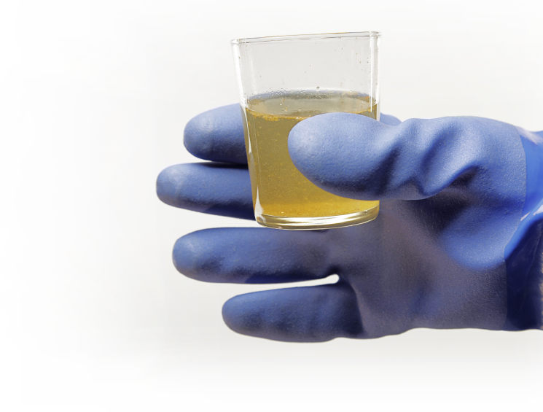
Health Effects of Toxic Exposures
Persistent Organic Pollutants
  Dioxins, DDT, PBDE’s, Lindane, and PCB’s are known carcinogens
  Documented high fetal “wastage”: Spontaneous abortion
  Endocrine and immune systems affected
  Decreased sperm counts and abnormal spermatozoa
  Neural tissue effects profound in fetus and young

Slide 21

The Problem Starts in Children
The Scope of the problem
Chronic diseases have become the major causes of illness, hospitalization and death in American children
    Asthma
    Cancer
    Birth defects
    Neurodevelopmental disorders
    Obesity and Diabetes

Slide 22
Childhood Leukemia

Slide 23
Childhood Obesity:
It’s not just lack of exercise
Overweight and Obesity Source: Willet et al., New Eng J Med, 1999
Prevalence has nearly quadrupled in American children
2.5-fold increased risk of overall mortality
4-fold risk of cardiovascular mortality
5-fold risk of diabetes
Risk of hypertension, gall bladder disease, and some cancers
Increasing role of endocrine disruptors – phthalates and Bisphenol A

Slide 24
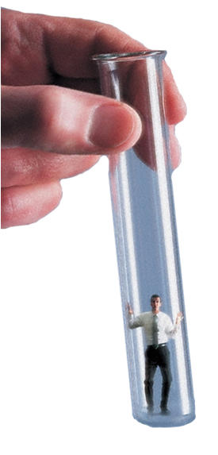
The Concept of Toxic Burden
“The Living Test Tube”
Over 4 million chemicals recognized by EPA
  80,000 commercially made (3 new ones per day)
  EPA study mid 1990’s..71% of 7,000 individuals had significant levels of agents NOT in existence 10 years previously!
Most of these chemicals not metabolized and only minimally excreted
Unknown long term consequences…
Today: Lung cancer in non-smokers, increased lymphoma, testicular cancer, early Alzheimer’s, more autism, ADHD.
So…What Can We Do? Are we Helpless?

Slide 25
The Invisible Killers
The Unseen Dangers of a Toxic World

